Slide 2
How to Enroll in and Access the ENLS Course

Slide 3
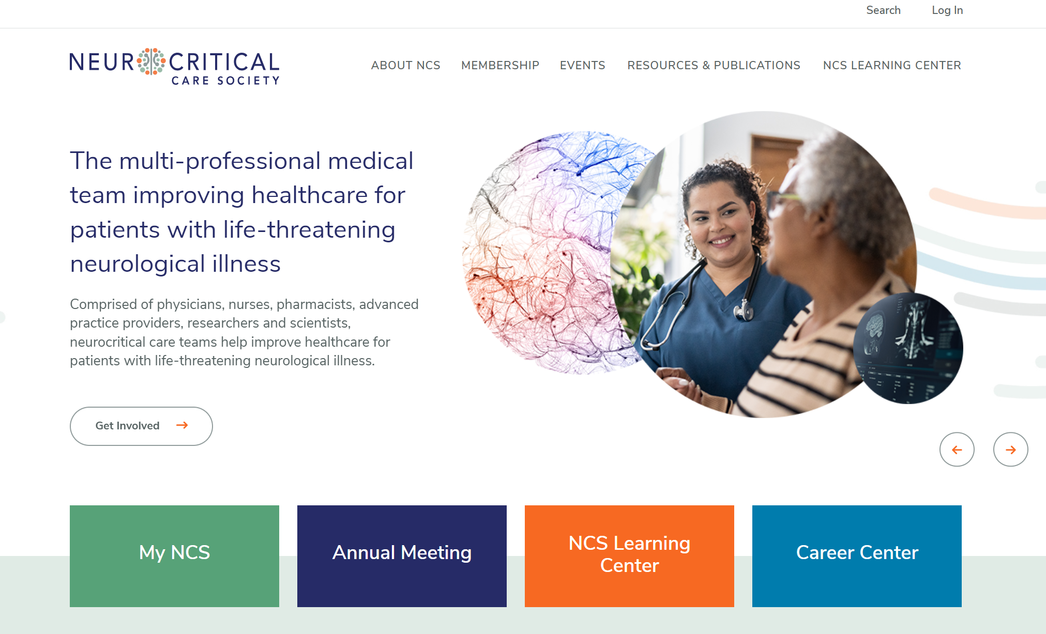
Go to www.Neurocriticalcare.org, then Log In

Slide 4
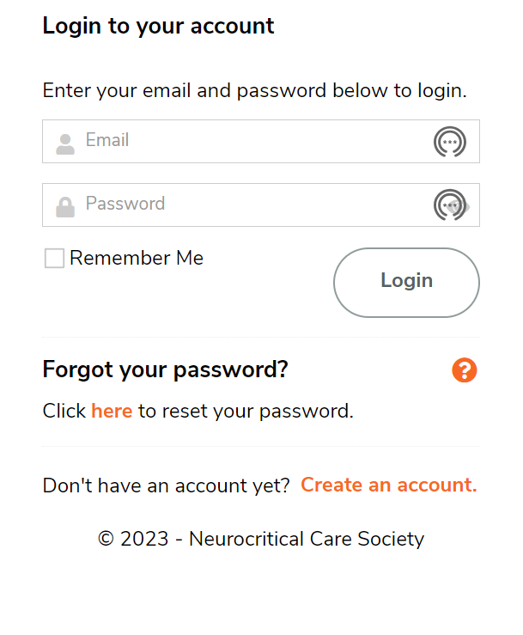
Log in or create a (free) Guest account
Existing account
Guest account

Slide 5
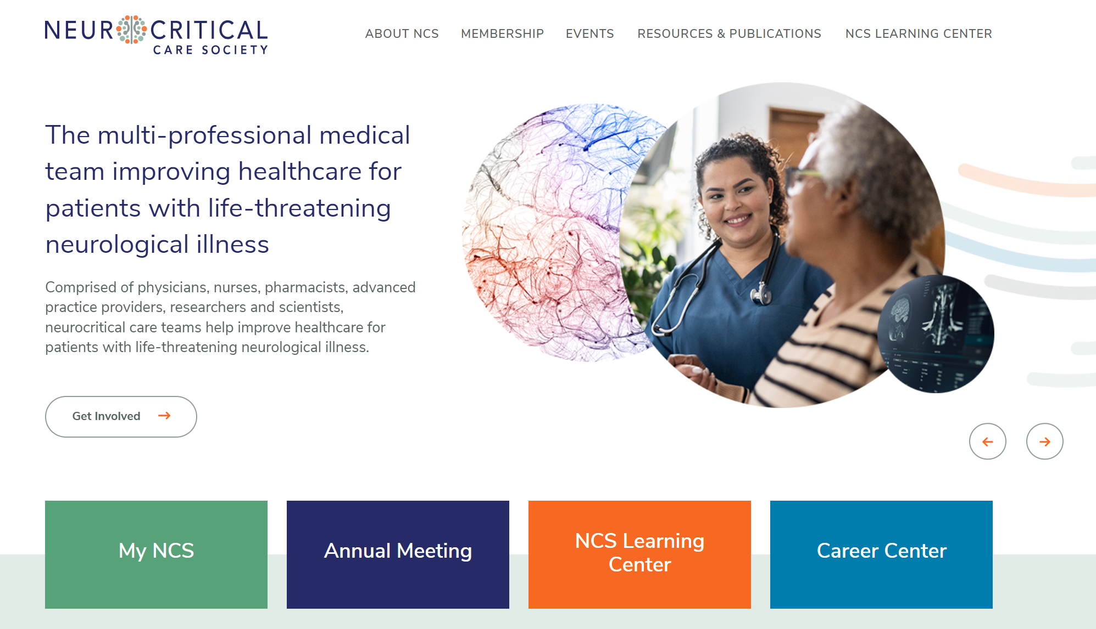
Once logged in, click on NCS Learning Center

Slide 6
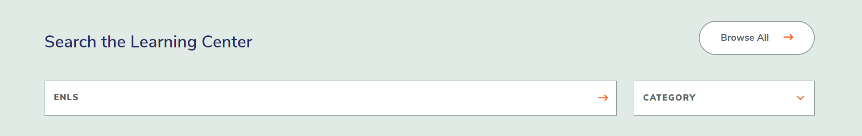
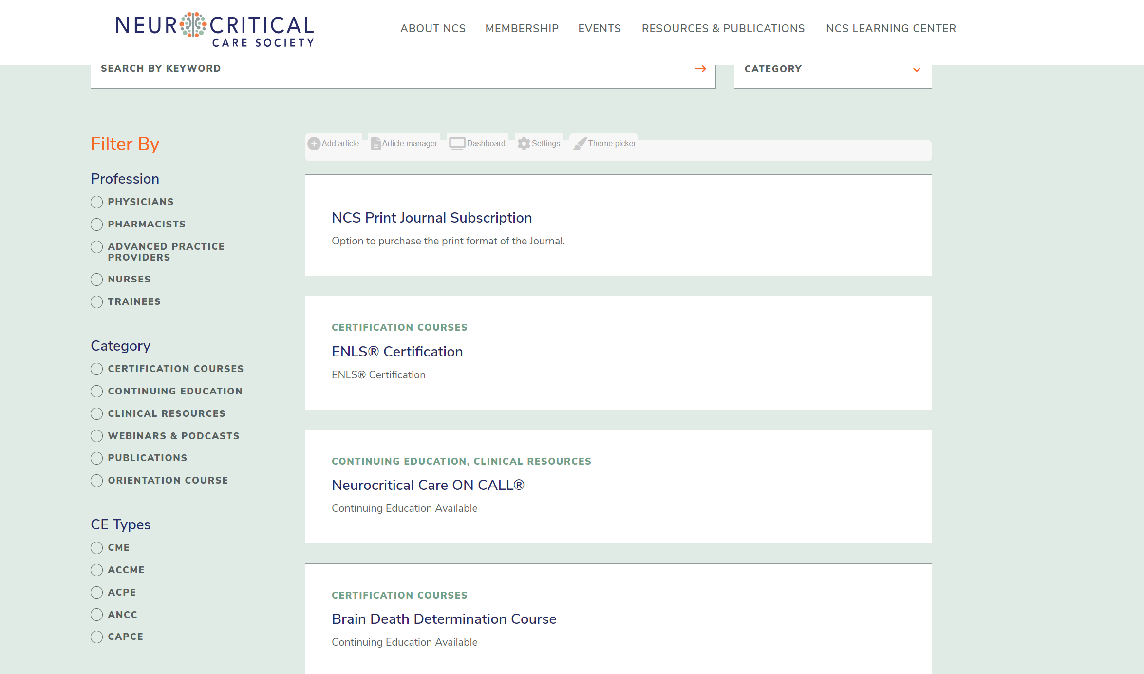
In the Search By Keyword box type ENLS and then click Browse All
And a list of courses will appear:

Slide 7
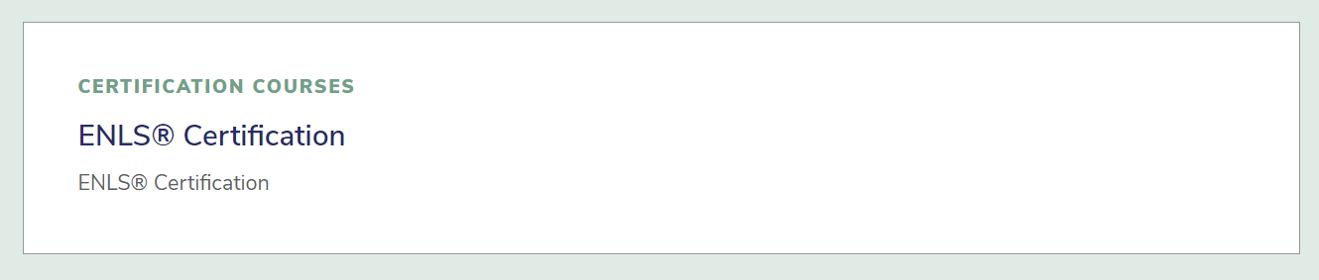
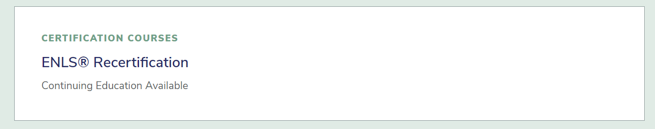
Select the appropriate course
First time certifying? Select
Certified previously? Select
  NOTES: (1) You may recertify at 22 months. (2) Time passed since last certification or expiration is irrelevant – if you have previously certified, you MUST enroll in the ENLS Recertification Course!)

Slide 8
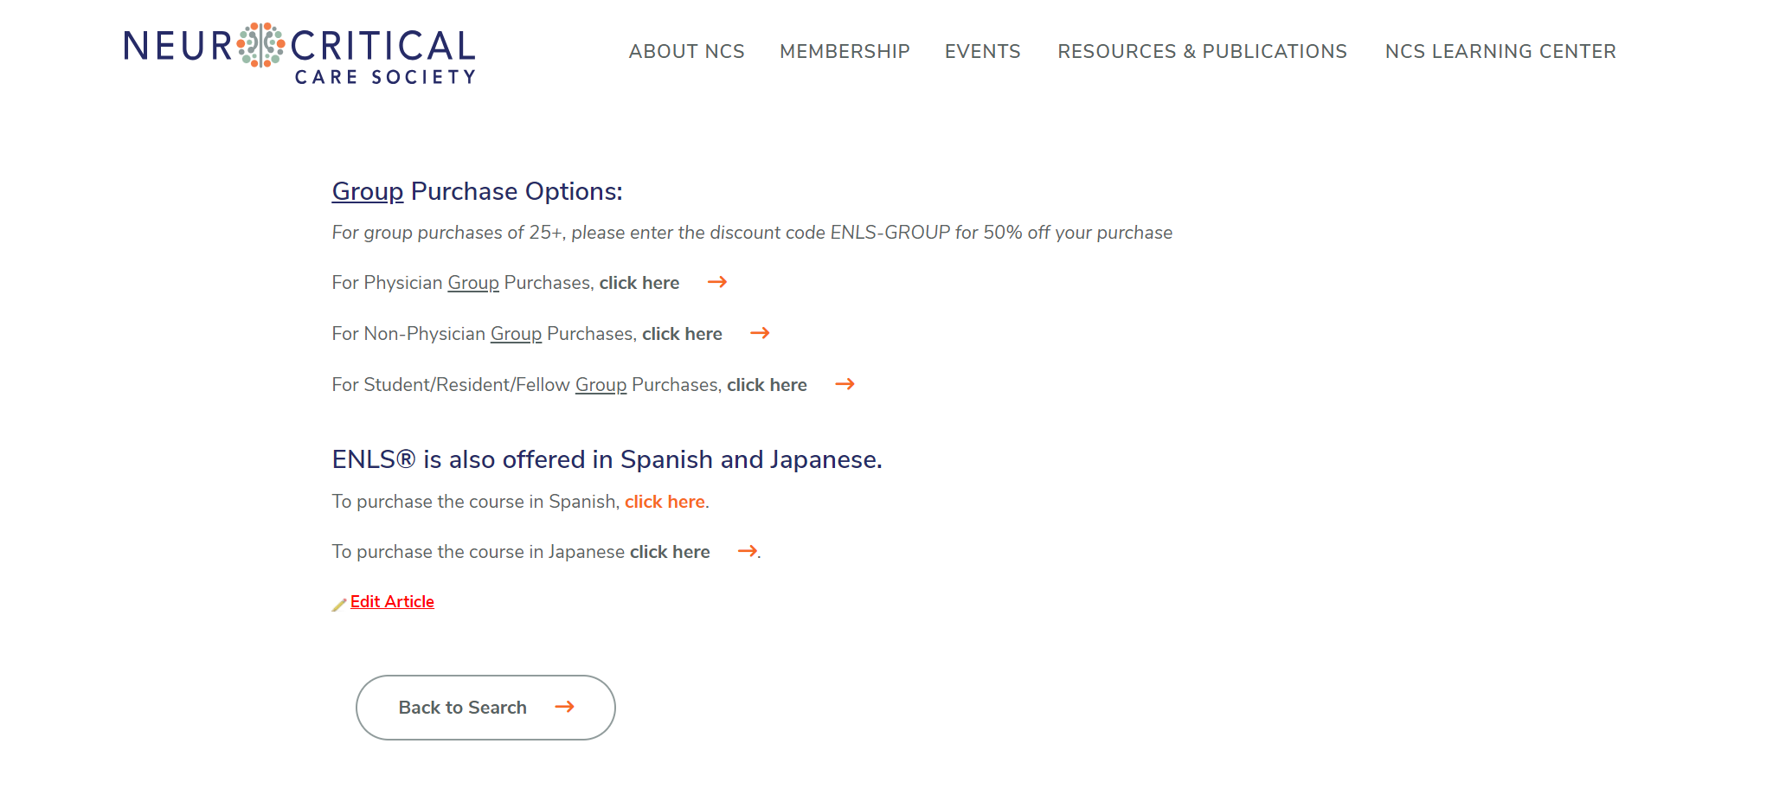
Select preferred language

Slide 9
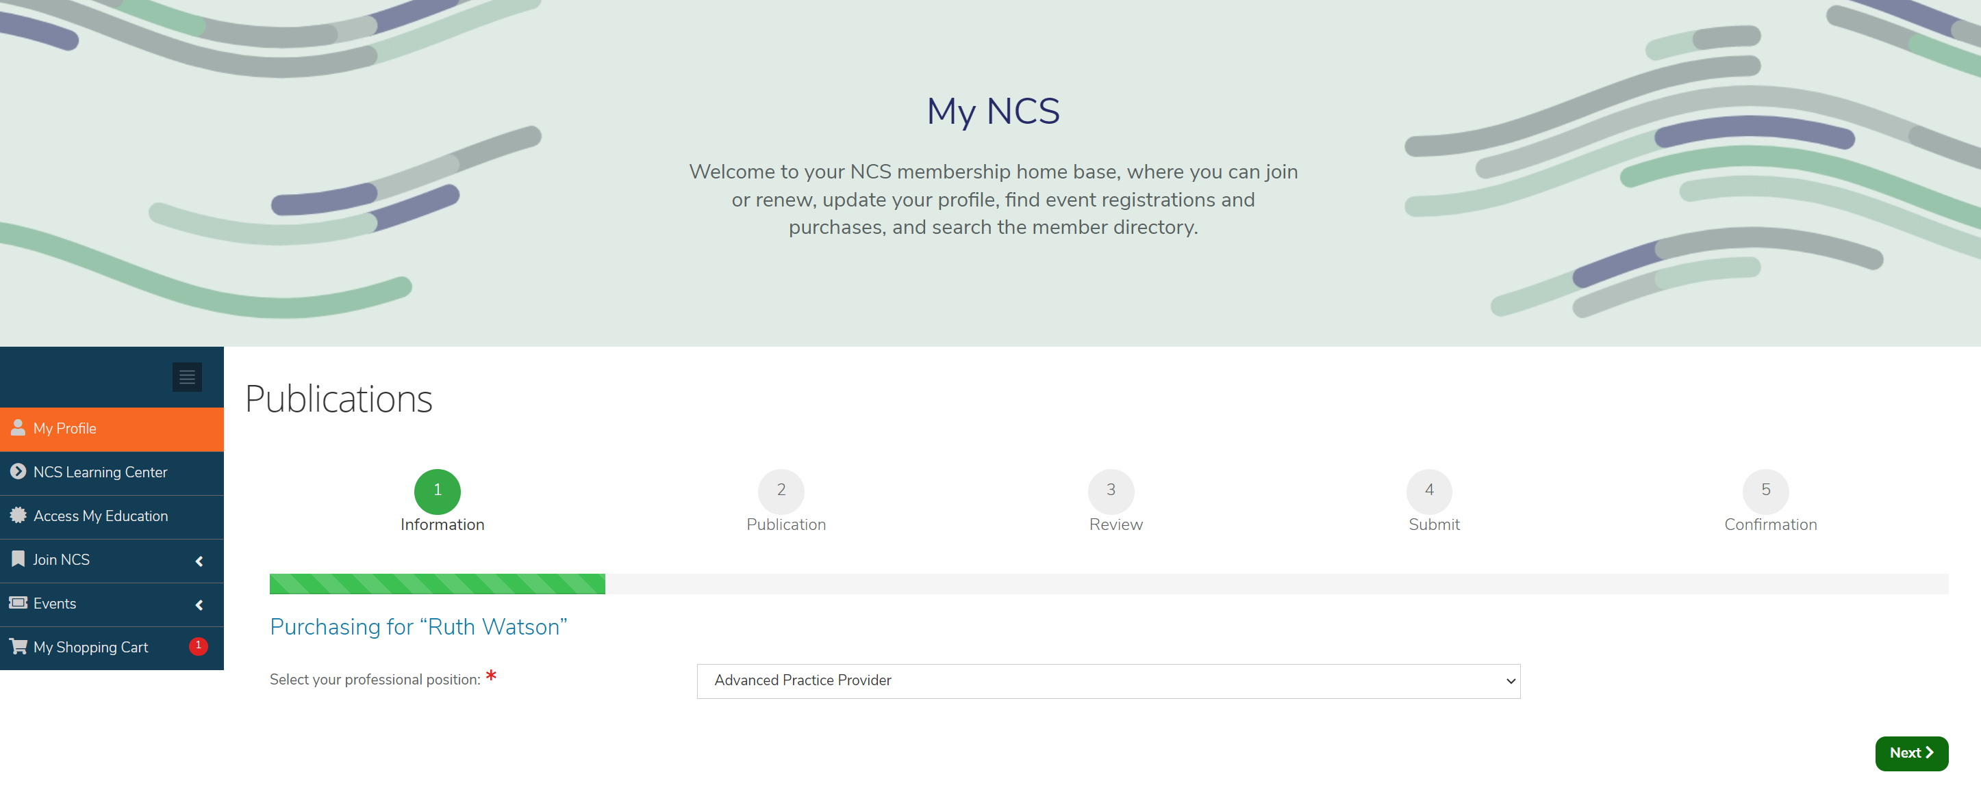
Ensure your professional position is selected and click Next
NOTE: Non-physicians include RN, APP, PharmD, prehospital, etc.

Slide 10
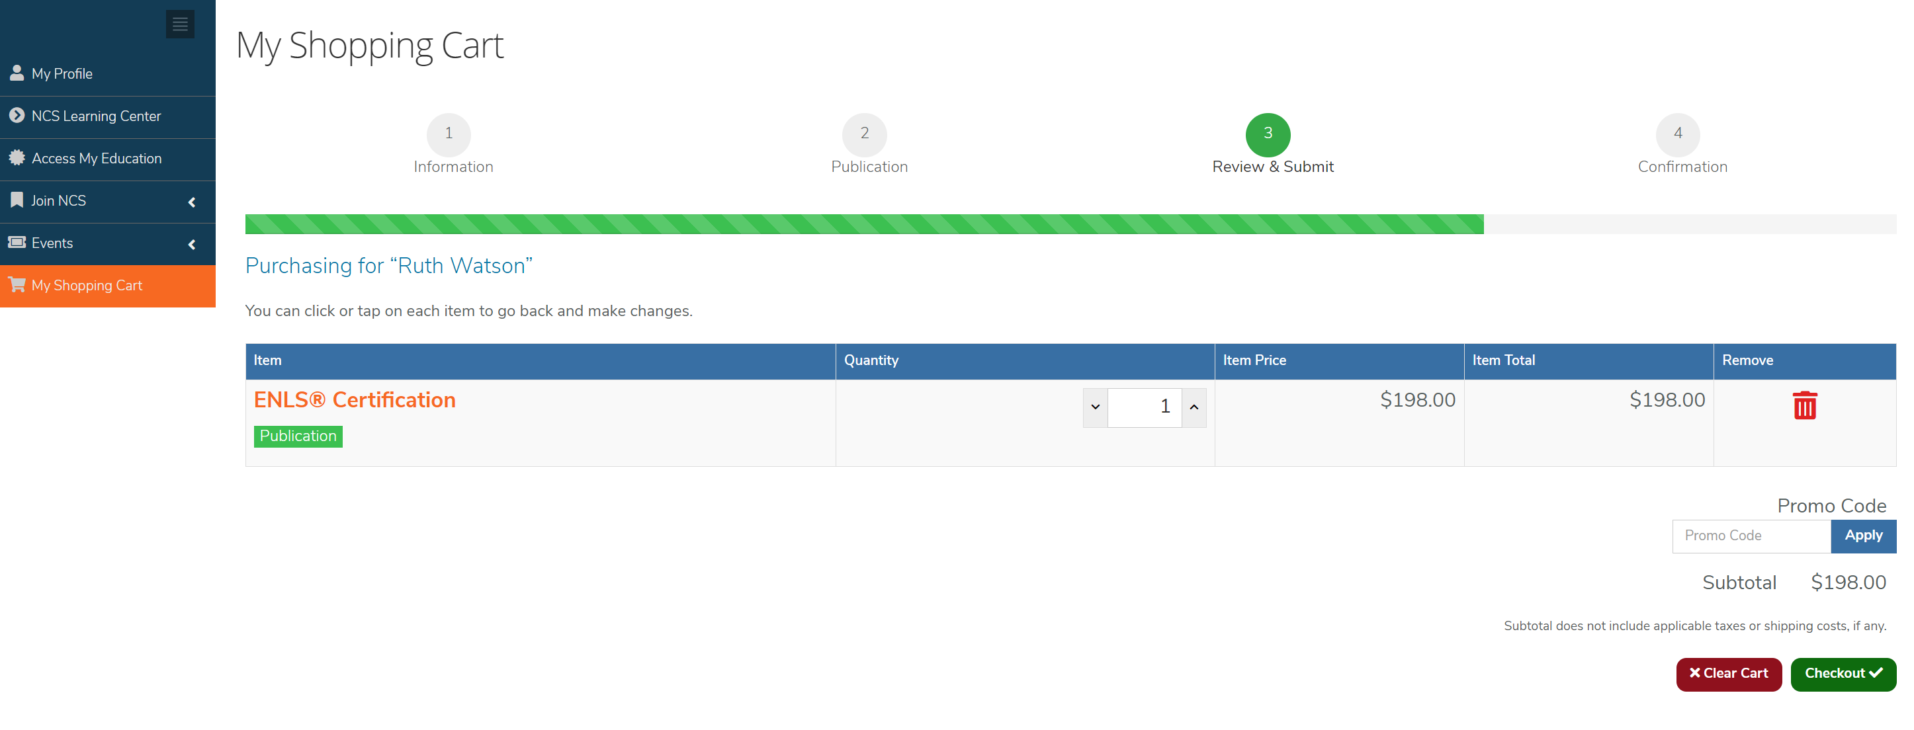
IMPORTANT: If applicable, click into Promo Code to enter a discount code for your course fee!
Click “Apply” and then “Checkout”

Slide 11
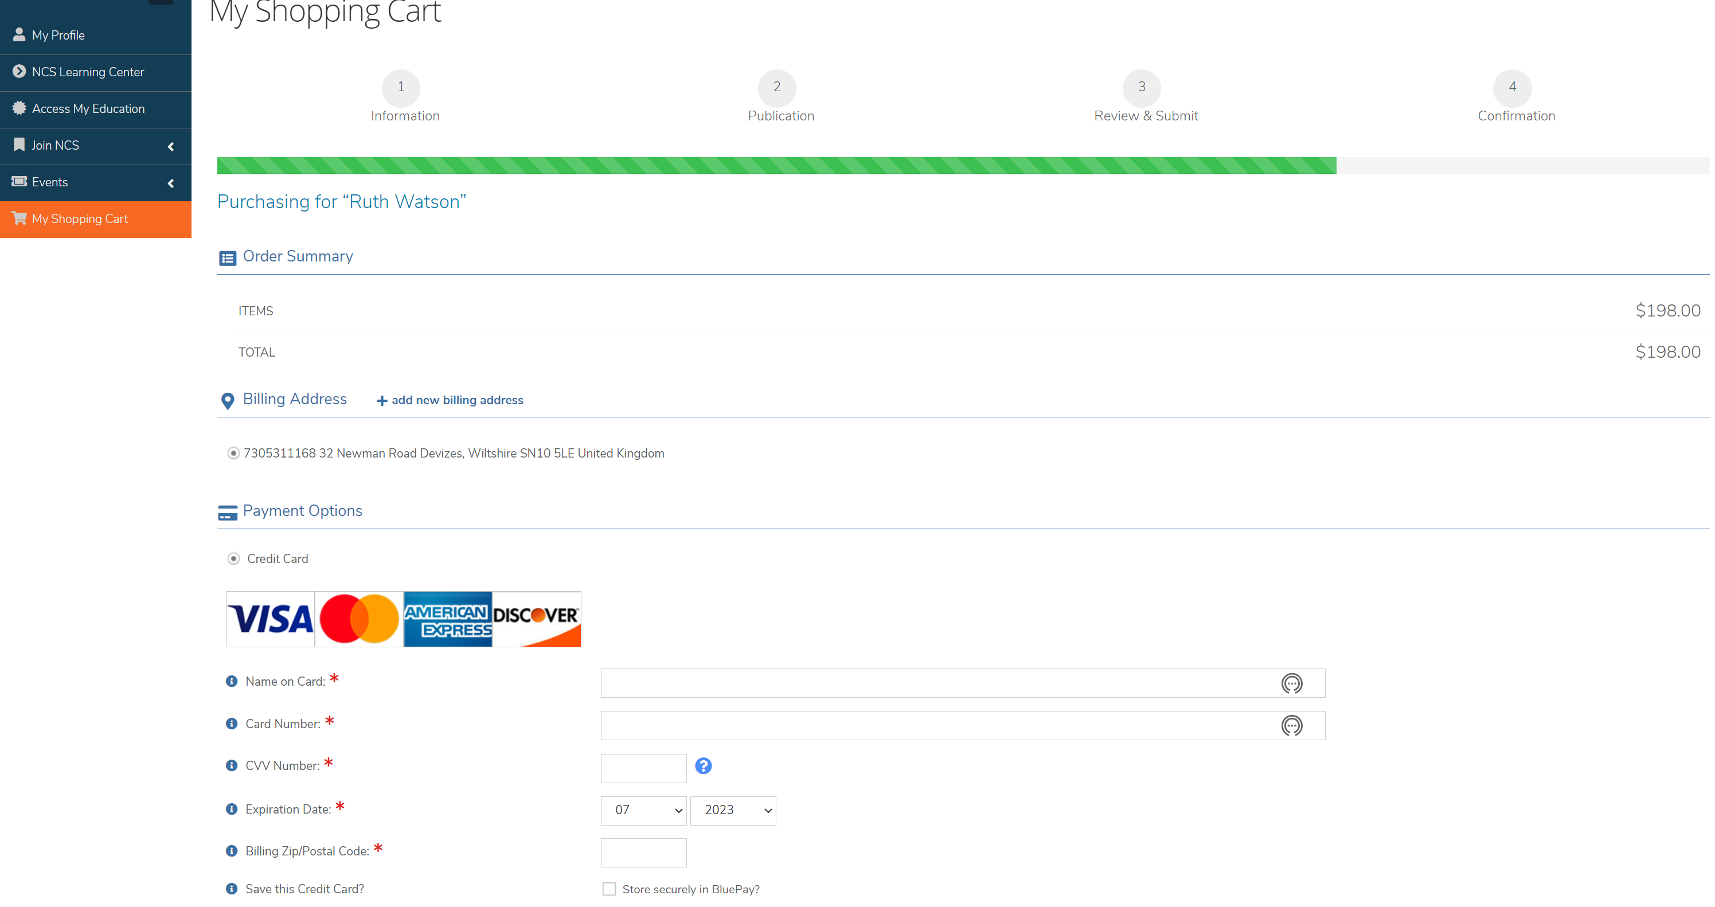
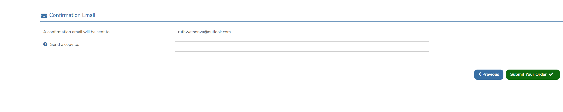
Check your payment details and click “Submit Your Order”

Slide 12
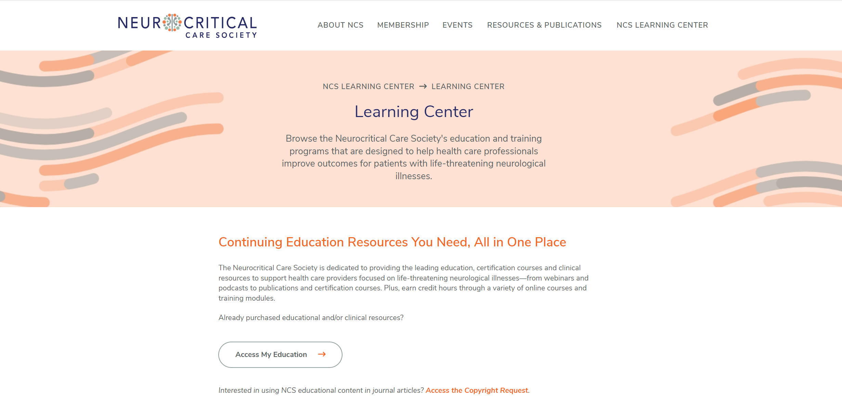
Go to the NCS Learning Center www.neurocriticalcare.org/NCS-Learning-Center/Learning-Center
Click on “Access My Education”

Slide 13
What you need to know about ENLS:
The ENLS Course is divided into a total of 14 sections, or modules.
Modules include reference materials, protocols, lecture slides, exams, and other files.
To complete certification, each exam must be passed with a score of 70% or above.
Exams may be taken unlimited times, and may also be re-taken after passing.
The course is self-directed. You may log in/out as many times as necessary.
You may download and print a Certificate of Completion after completing the course (passing all exams) and providing feedback.
You may claim up to 15 hours of CME for the ENLS Course, and 8 hours of CME for the ENLS Recertification Course.
You will have access to the course and materials for the duration of enrollment (two years).
You will be eligible for recertification at 22 months, or two months before expiration.

Slide 14
Thank you for your support of the
Neurocritical Care Society,
and for taking the ENLS Course.
Enjoy!

